Slide 1

Housekeeper Scheduling System ( 218 JAVA SL VB BATCH-13 Group – 5 )
Presented By: Pavithra B
Ronali Panda
Nischal B Patil

Slide 2
Team Members
FrontEnd Members
BackEnd Members
Nischal B Patil (Lead)
Pavithra B
Ronali Panda
Dhananjay Dinkar Merat
Jatin X
Nagolu Suresh
Gone Nitheesh
Ashok Uttam Bhise
Chintapalli Shaik Farook

Slide 3
Table Of Contents
Abstract.
Objective.
Project Architecture.
Tools and Technologies Used.
Advantages.
Screenshots.

Slide 4
Abstract :
The main objective of HOUSEKEEPER SHEDULING SYSTEM is hostel students can use to get their rooms cleaned on time.
Admin will select a housekeeper.
Using this HOUSEKEEPER SHEDULING SYSTEM Admin can Add, Edit and Delete details.
By using HOUSEKEEPER SHEDULING SYSTEM we can maintain the feedback and request status of the user.

Slide 5
Objective :
The function will automatically generate cleaning plans.
The housekeeping department takes pride in keeping the hotel clean and comfortable.
Good housekeeping is considered as the backbone of accommodation sector.
Housekeeper to perform cleanliness duties most efficiently and effectively.

Slide 6
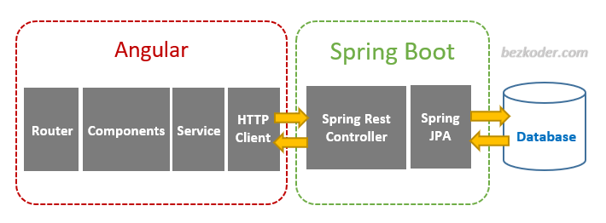
Project Architecture :

Slide 7
Tools & Technologies Used :
Front-End : Angular
Server-side : Spring Boot
Back-end : MYSQL, Hibernate
Server : Tomcat

Slide 8
HTML & CSS :
HTML and CSS are two of the core technologies for building Web pages.
HTML provides the structure of the page, CSS the (visual and aural) layout, for a variety of devices.
Along with graphics and scripting, HTML and CSS are the basis of building Web pages and Web Applications.
HTML is the language for describing the structure of Web pages and CSS is the language for describing the presentation of Web pages, including colors, layout, and fonts.

Slide 9
Angular :
Angular is a platform and framework for building single-page client applications. using HTML and TypeScript.
Angular is written in TypeScript.
The architecture of an Angular application relies on certain fundamental concepts.
The basic building blocks of the Angular framework are Angular components that are organized into NgModules.

Slide 10
MySQL :
MySQL is currently the most popular database management system software.
MySQL databases are relational.
It is open-source database software, which is supported by Oracle Company.
It is fast, scalable, and easy to use database management system.
MySQL follows the working of Client-Server Architecture.

Slide 11
Modules :
The system comprises of 2 major modules with their sub-modules as follows:
Admin Module :
Login: Admin can login his personal account.
Dashboard: Where all the details are displayed.
Allot: Admin can allot a housekeeper.
Complaints: Complaints which are raised by the user are displayed.
Suggestions: Suggestions which are given by the user are displayed.
Register Student: Admin can register a new student.
Register Housekeeper: Admin can register a new housekeeper.
Logout: Admin can logout after the completion of his work.

Slide 12
2. User Module :
Login: User can login his personal account.
Dashboard: Where all the details are displayed.
Requests: User can request a housekeeper by selecting date and time.
Feedback: User gives the feedback like suggestions and complaints about the housekeeper performance.
Profile: Details of the User.
Logout: User can logout after the completion of his work.

Slide 13
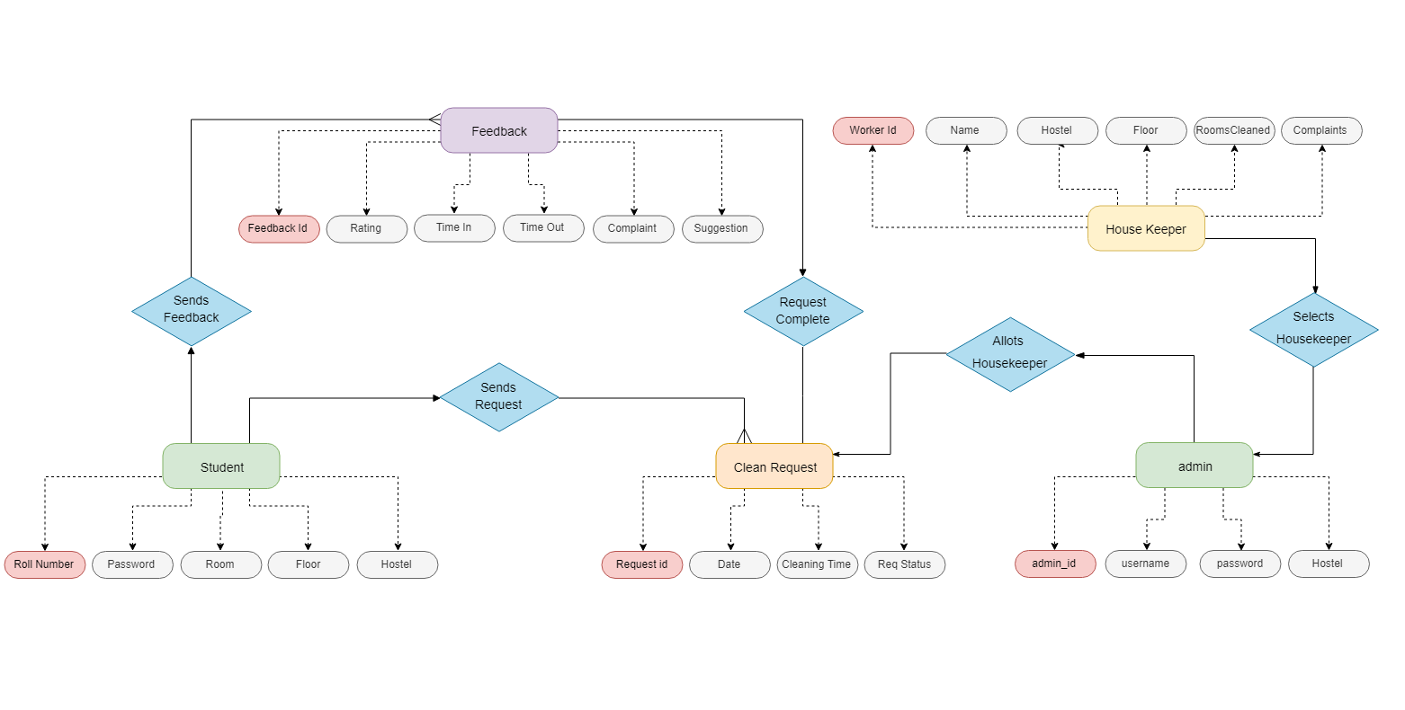
Class Diagram :

Slide 14
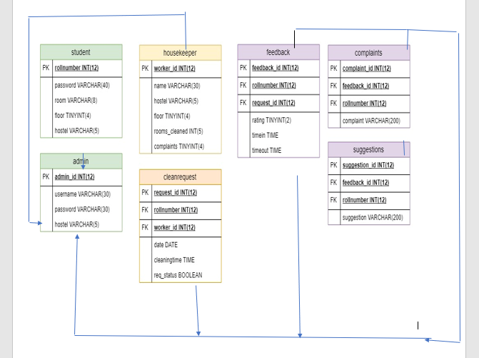
ER Diagram :

Slide 15
Advantages :
This system is very easy to understand and user friendly.
Student and Housekeeper are connected with each other on one system.
This system is saving the time for student and hostel warden too.
In this system user can connect any time whenever he/she wants.
This system is secure.

Slide 16
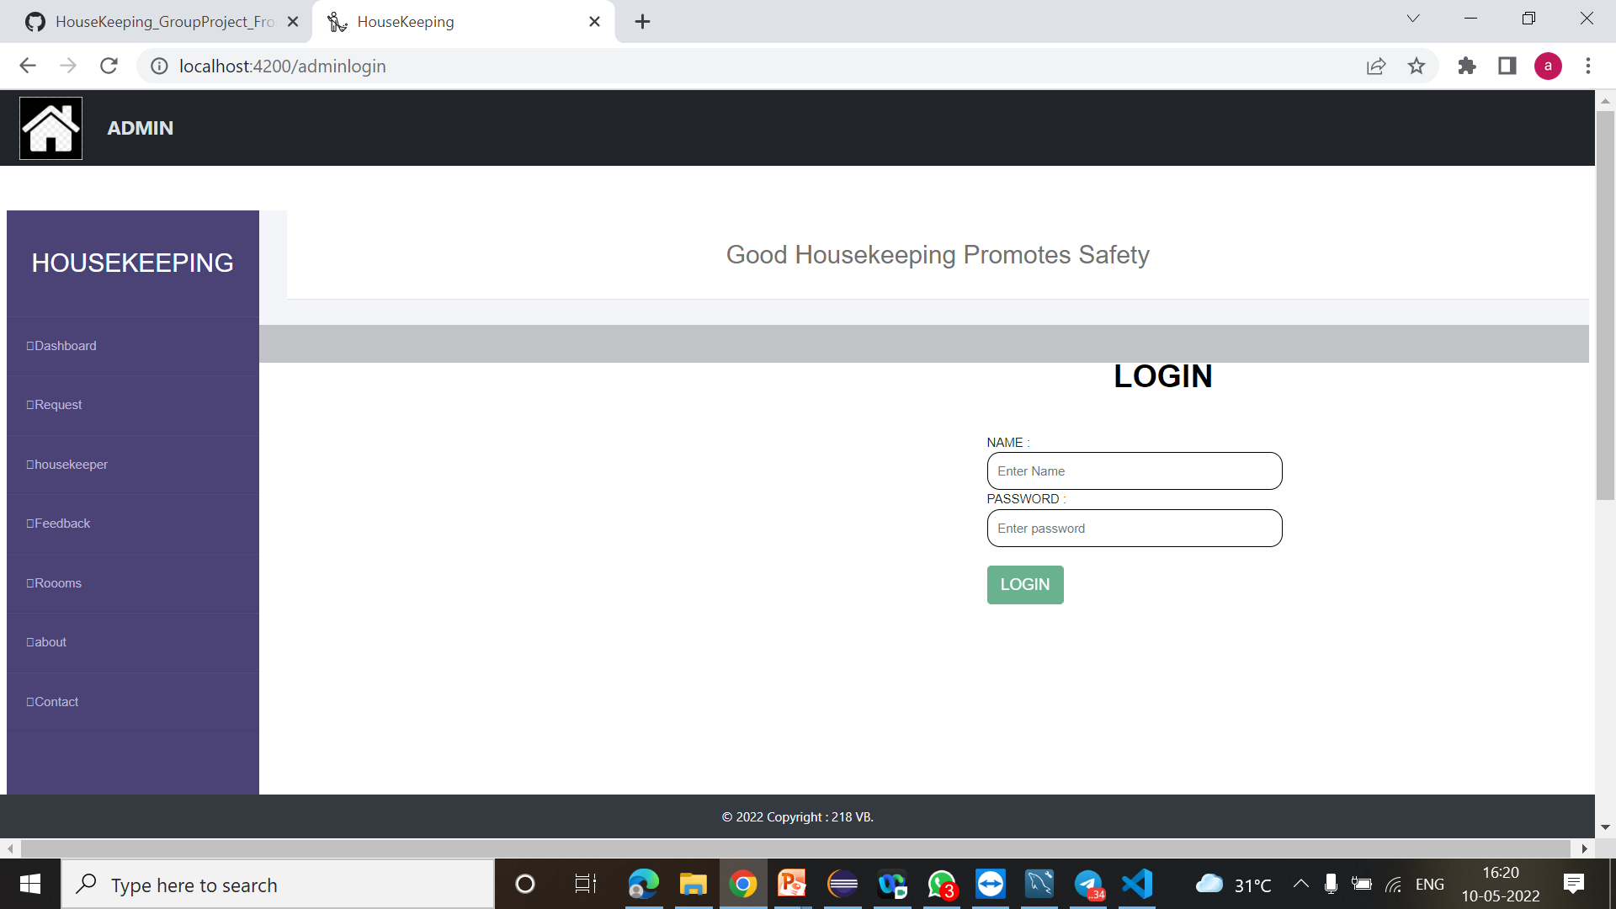
Screenshots: (Login Page)

Slide 17
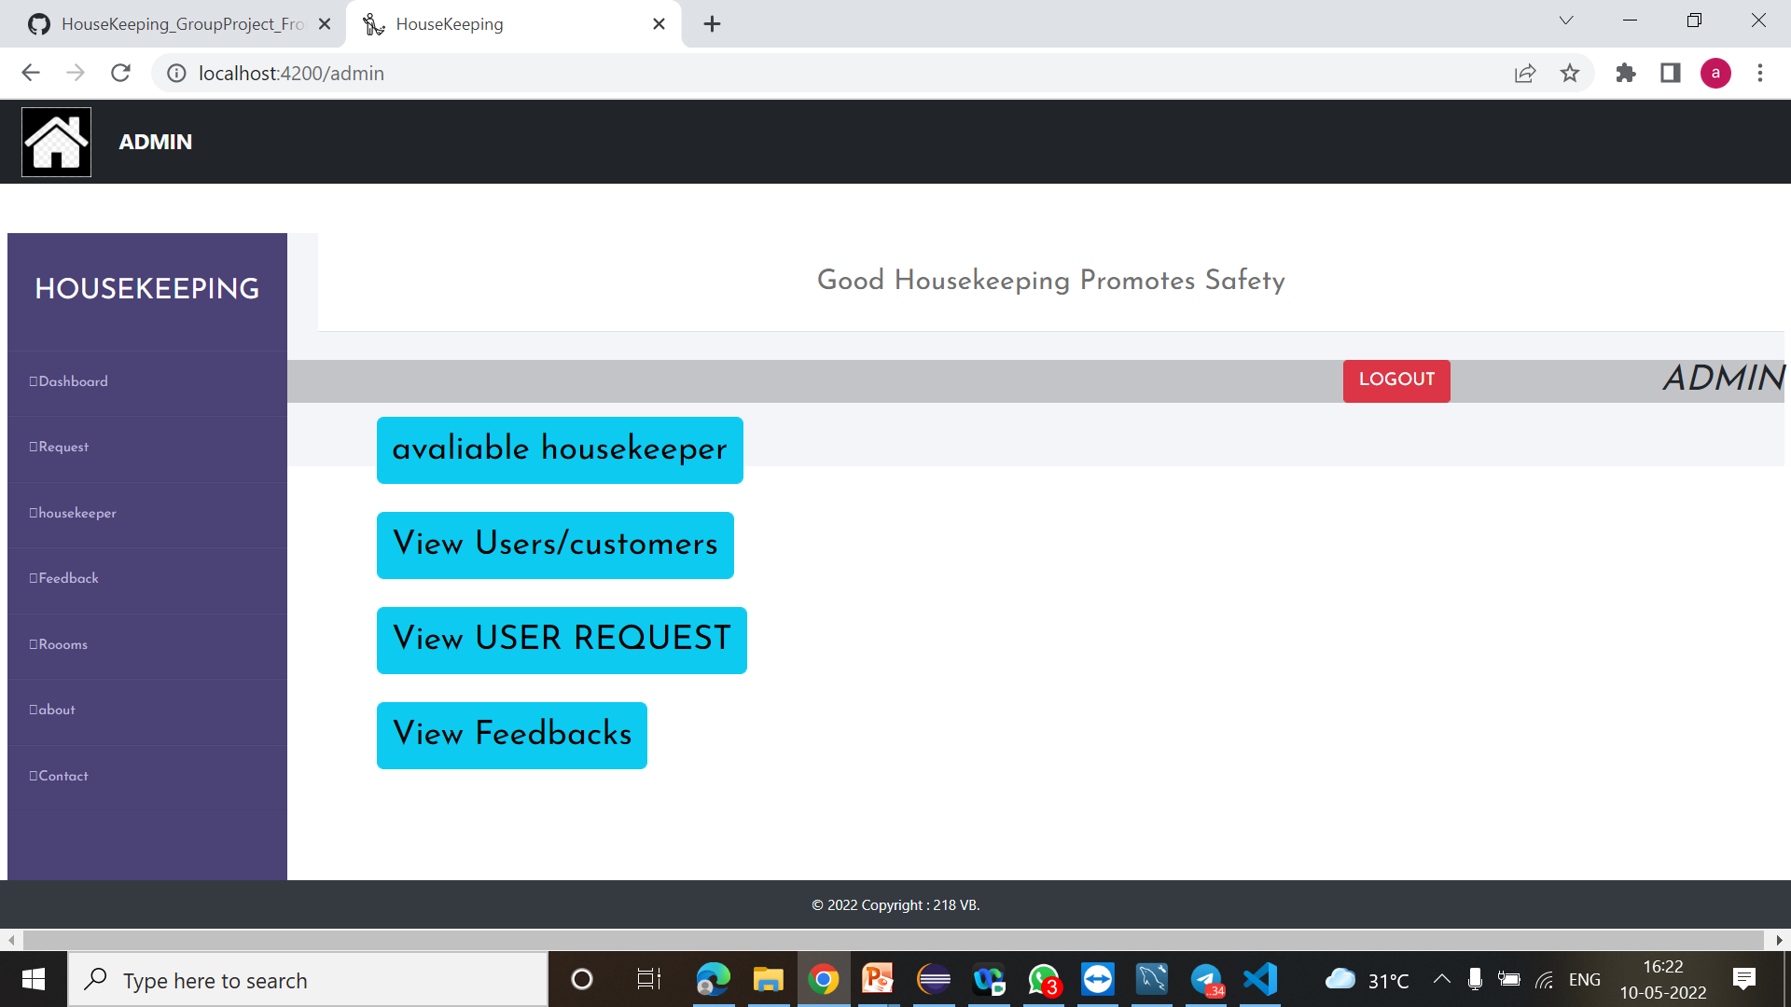
Admin Dashboard :

Slide 18
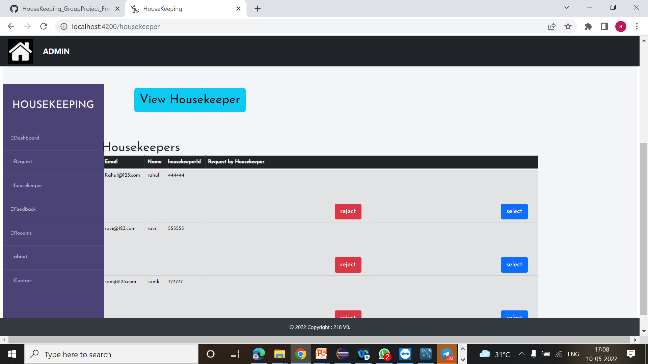
Allot HouseKeeper :

Slide 19
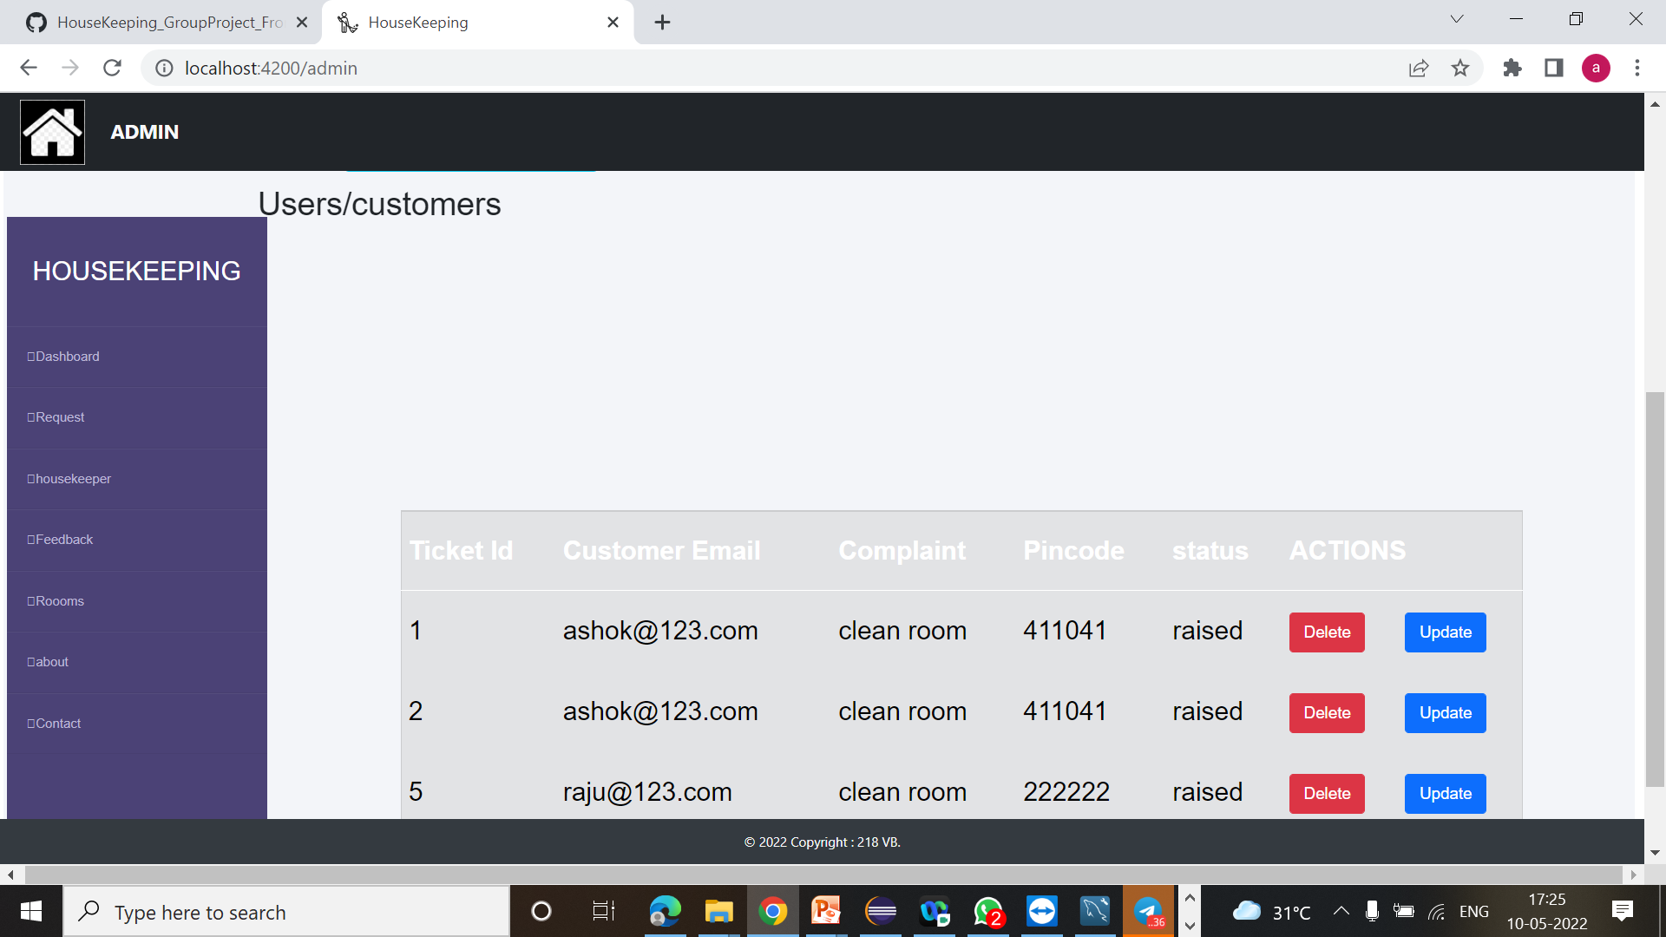
Complaints :

Slide 20
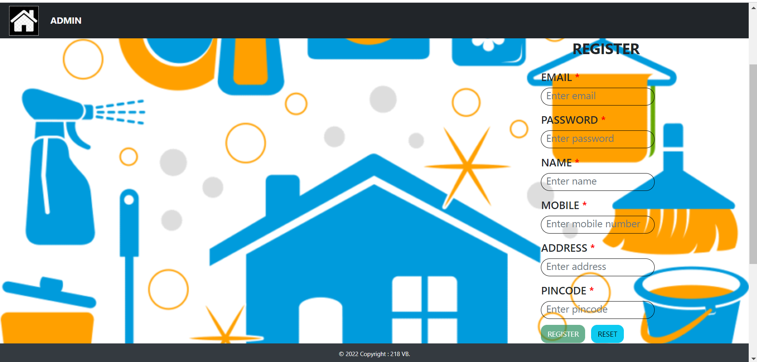
Register New Student:

Slide 21
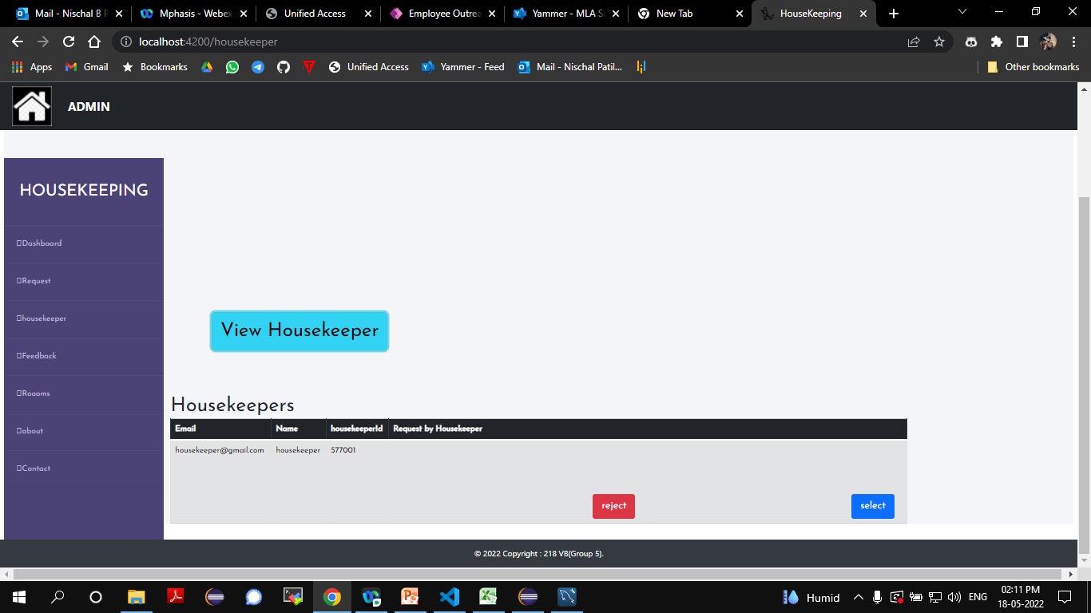
View Housekeeper:

Slide 22
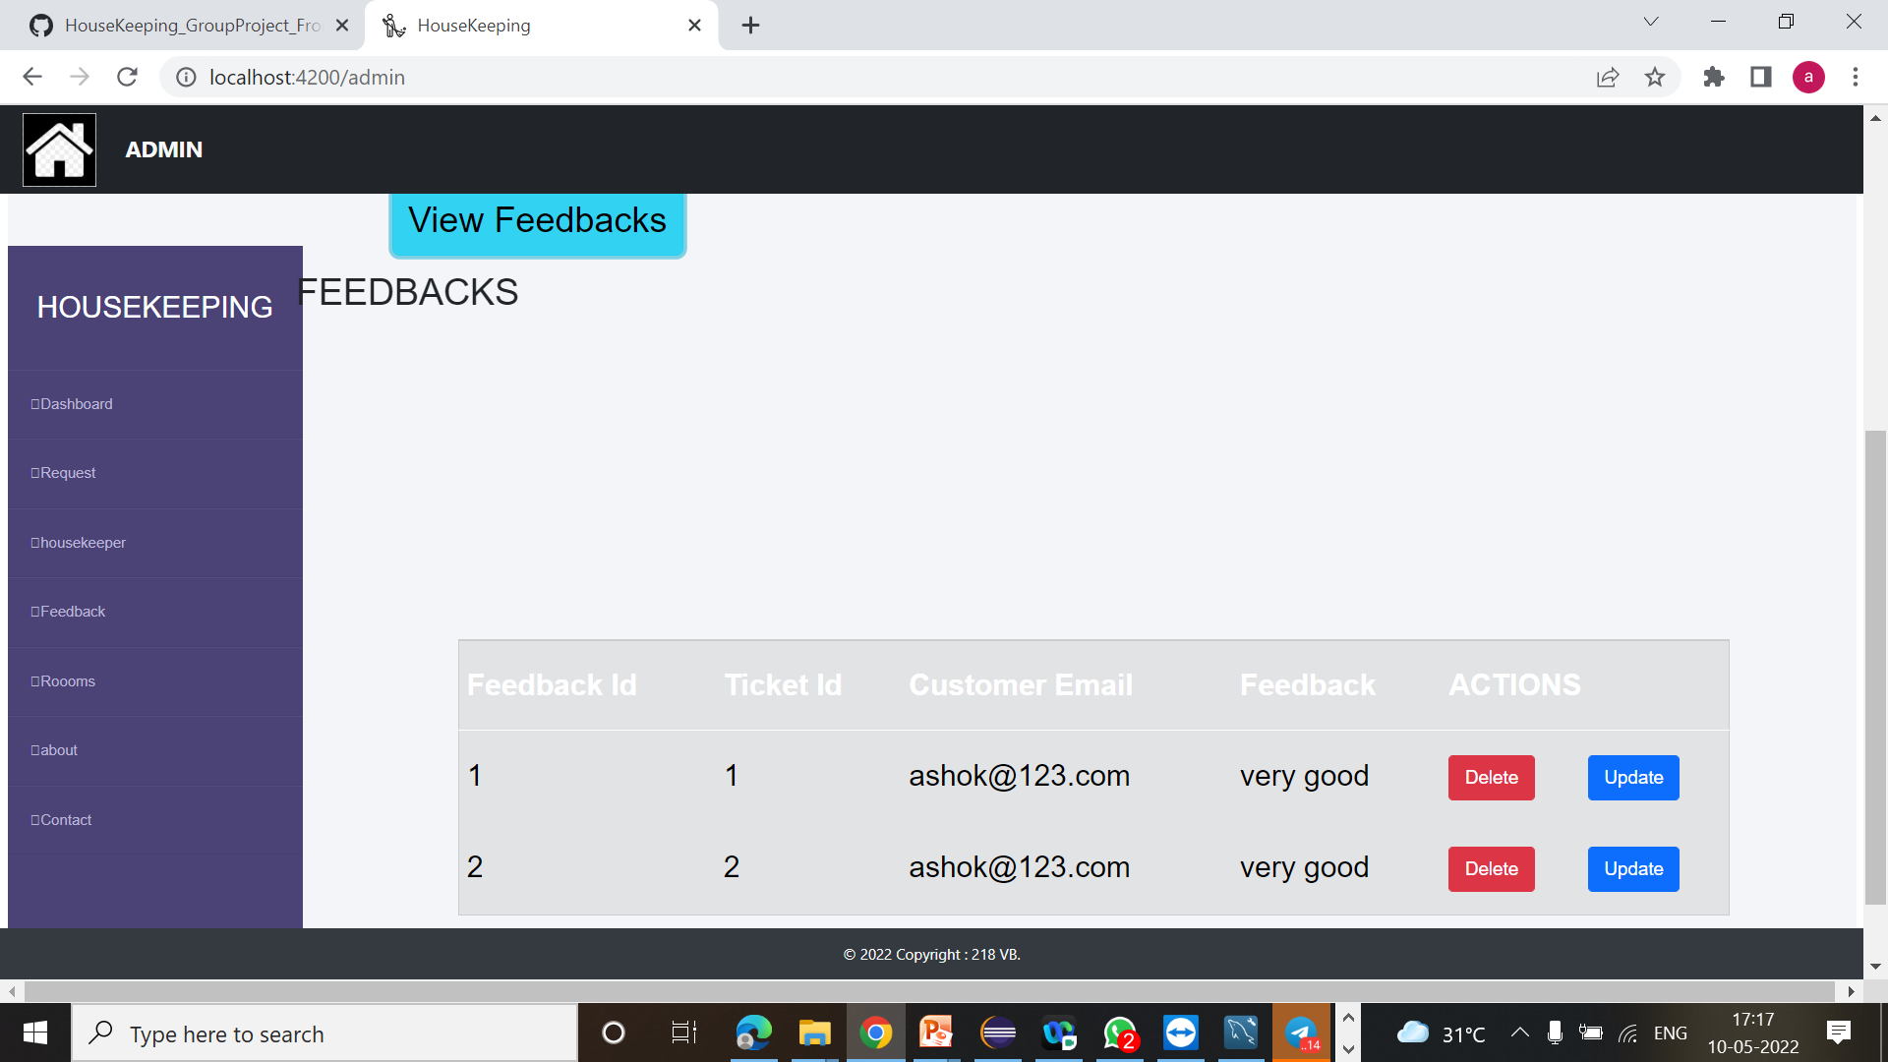
User Feedback:

Slide 23
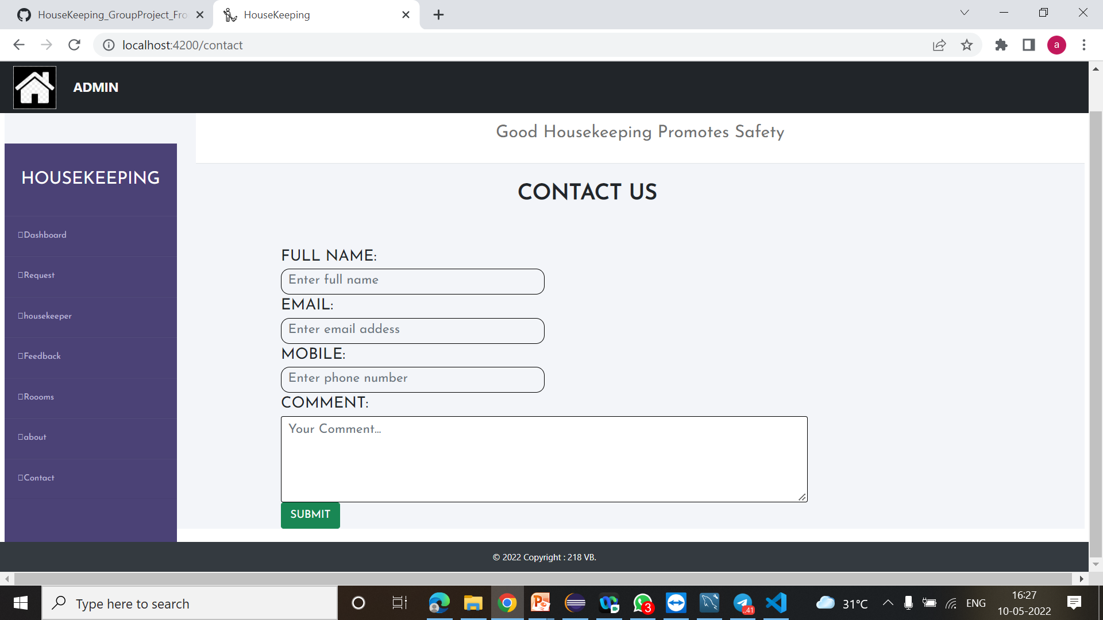
Suggestions :

Slide 24

Cccc

